Slide 1

50.039 Theory and Practice of Deep Learning W4-S1 Introduction to Computer Vision and Convolutional Neural Networks
Matthieu De Mari

Slide 2
About this week (Week 4)
What are images and how is this datatype represented?
What is a pixel and how can its information be interpreted?
What is the spatial dependence property of pixels?
What is the homophily property of pixels?
Why is the linear processing operation failing on images?
What is the convolution operation?
How can we perform image processing using convolutions?
What is padding in convolutions?

Slide 3
About this week (Week 4)
What is stride in convolution?
What is dilation in convolution?
How does convolution apply to higher dimensional images?
How to write our own convolutional processing layer in PyTorch?
What is Conv2d in PyTorch?
What is a Convolutional Neural Network (CNN)?
What is the intuition behind using Convolutional layers in a Convolutional Neural Network?

Slide 4
About this week (Week 4)
How to train our first Convolutional Neural Network on MNIST?
What are other typical image processing layers in Computer Vision and how are they implemented?
What is the pooling layer?
What is the batchnorm layer?
What is the dropout layer?
What is data augmentation in Computer Vision?
What are some milestone Computer Vision models and their contributions to the field of Deep Learning?

Slide 5
About this week (Week 4)
What are the AlexNet and VGG models?
What is a skip connection/residual? What is its effect on a Neural Network and how does it help with vanishing gradient problems?
What are ResNet and DenseNet models?
What is the Inception model?
What is the EfficientNet model?
What is transfer learning and its uses?
How to freeze and fine-tune layers in a Neural Network?

Slide 6
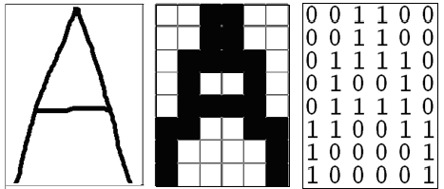
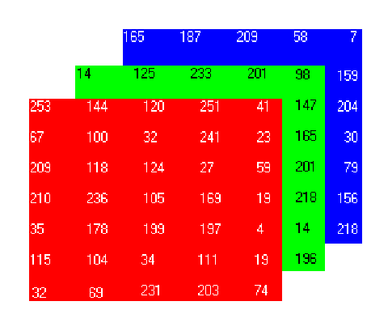
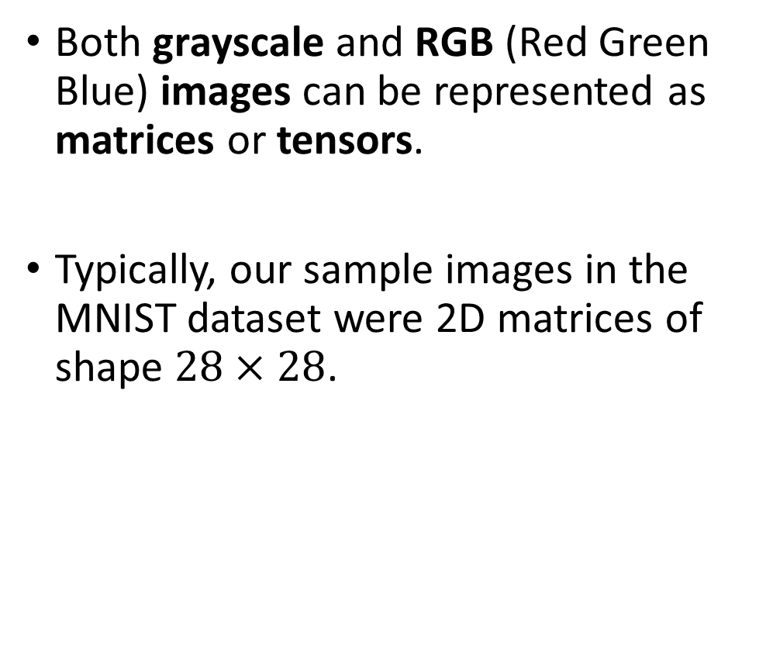
How to encode an image
Both grayscale and RGB (Red Green Blue) images can be represented as matrices or tensors.
Typically, our sample images in the MNIST dataset were 2D matrices of shape $28×28$.

Slide 7
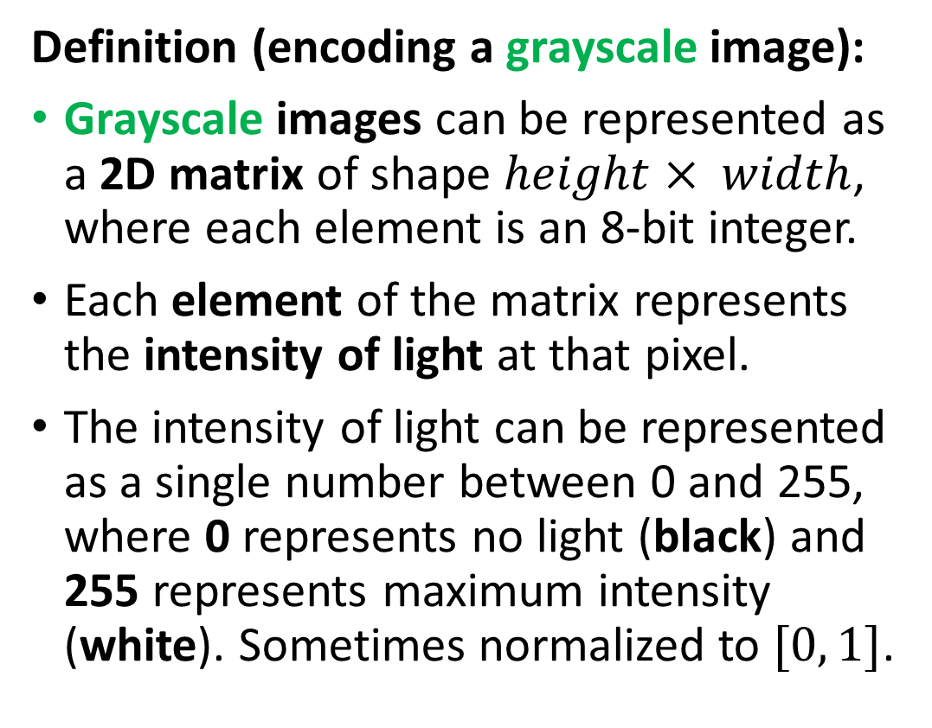
How to encode an image
Definition (encoding a grayscale image):
Grayscale images can be represented as a 2D matrix of shape $height× width$, where each element is an 8-bit integer.
Each element of the matrix represents the intensity of light at that pixel.
The intensity of light can be represented as a single number between 0 and 255, where 0 represents no light (black) and 255 represents maximum intensity (white). Sometimes normalized to $[0, 1]$.

Slide 8
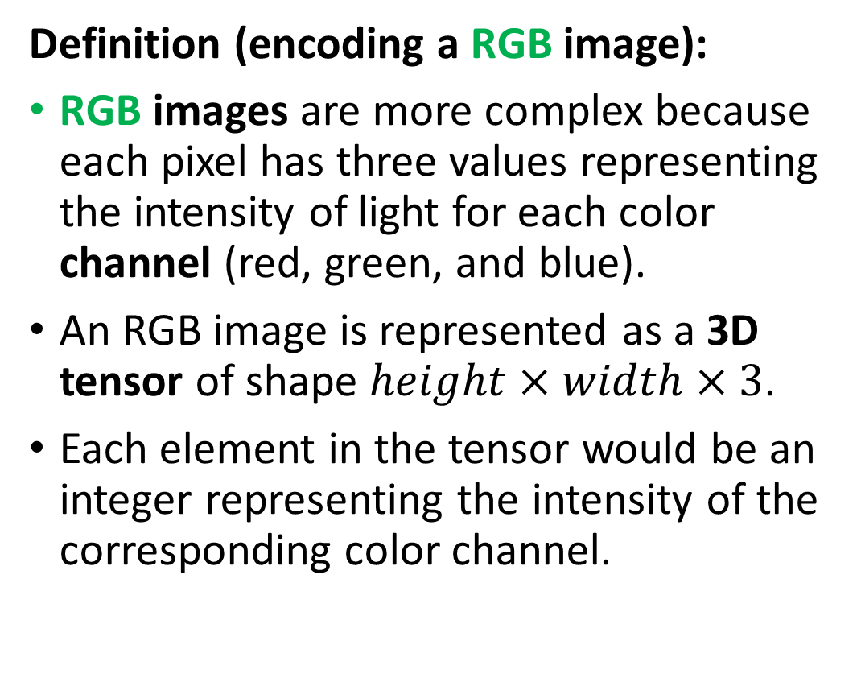
How to encode an image
Definition (encoding a RGB image):
RGB images are more complex because each pixel has three values representing the intensity of light for each color channel (red, green, and blue).
An RGB image is represented as a 3D tensor of shape $height×width×3$.
Each element in the tensor would be an integer representing the intensity of the corresponding color channel.

Slide 9
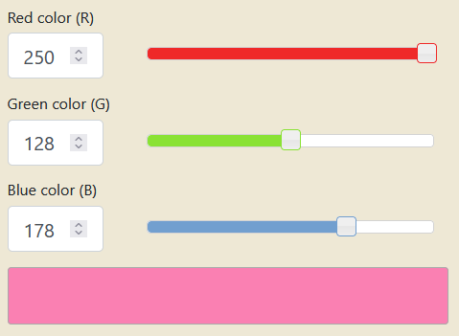
How to encode an image
Combining the red, green and blue values allows to generate any color. Try it!
https://www.rapidtables.com/convert/color/rgb-to-hex.html

Slide 10
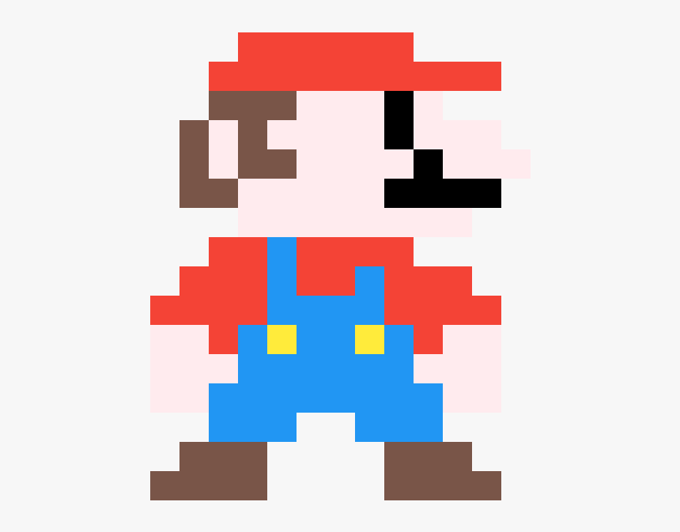
Pixels information
Each element in a Greyscale matrix or RGB matrix corresponds to a pixel, representing something in the image.
The problem, however, is that it is often impossible to guess the meaning of a given pixel, by looking at this pixel alone.

Slide 11
Pixels information
Can you guess what this pixel represents and what object it belongs to?
Flower petal
Piece of clothing
Skin of a human person
Feather of a bird

Slide 12
Pixels information
What if I show you some neighbouring pixels now?
Flower petal
Piece of clothing
Skin of a human person
Feather of a bird

Slide 13
Pixels information
What if I show you MORE neighbouring pixels now?
Flower petal
Piece of clothing
Skin of a human person
Feather of a bird

Slide 14
Pixels information
What if I show you MORE neighbouring pixels now?
Flower petal
Piece of clothing
Skin of a human person
Feather of a bird

Slide 15
The spatial dependence property
Definition (the spatial dependence property of pixels):
The spatial dependence property of pixels states that the meaning or interpretation of a single pixel in an image can often only be understood in the context of the pixels around it.
This is because the information in a single pixel is often not enough to describe the complete picture, or even just the pixel itself.
The relationship between the given pixel and its neighbouring pixels is necessary to provide a full understanding of this particular pixel, or even the image as a whole.
Images have “structure”, which is something we observed in the Mario pixel art example.

Slide 16
The homophily property
Definition (the homophily property of pixels):
Homophily in images refers to the phenomenon where pixels that are close to each other in space tend to have similar properties, such as color, texture, or intensity. In other words, is the tendency for similar pixels to be grouped together.
For example, in an image of a sky, pixels that are close to each other and have a similar blue color can often be grouped together and be considered part of the sky region.
This property is a key factor in image processing and computer vision algorithms, as it provides a way to segment images into meaningful regions and perform tasks like object recognition and image classification.

Slide 17
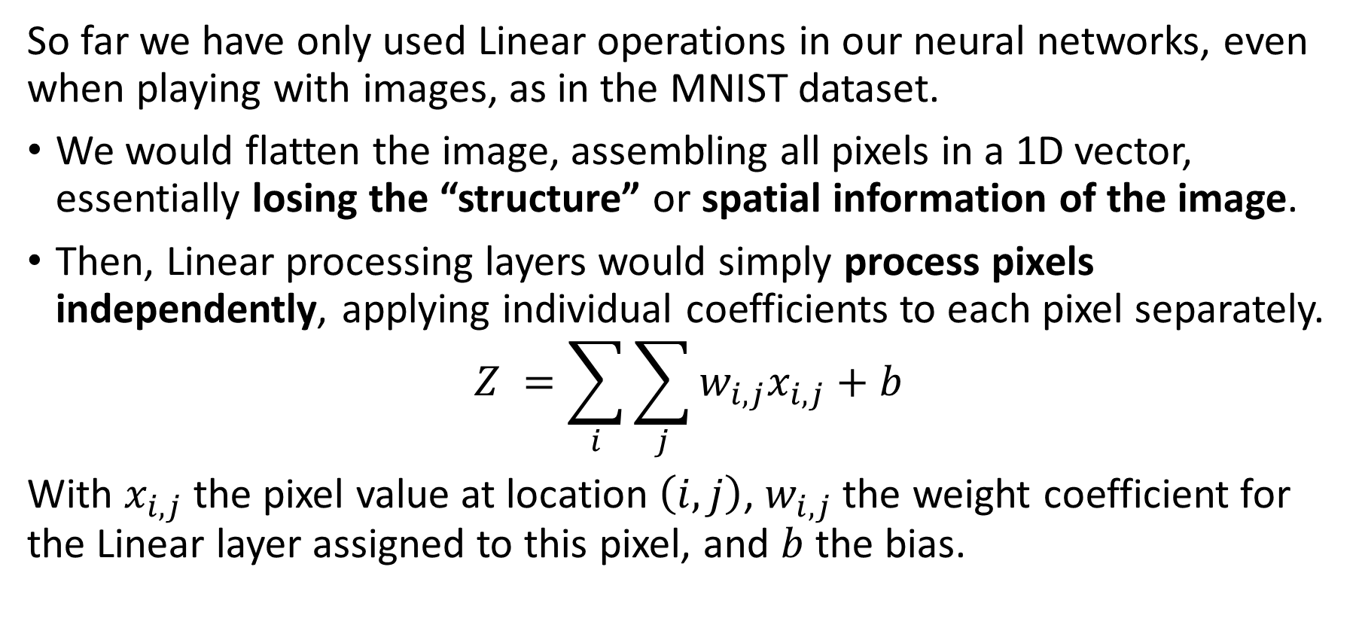
The problem with Linear processing
So far we have only used Linear operations in our neural networks, even when playing with images, as in the MNIST dataset.
We would flatten the image, assembling all pixels in a 1D vector, essentially losing the “structure” or spatial information of the image.
Then, Linear processing layers would simply process pixels independently, applying individual coefficients to each pixel separately.
$$Z =\sum_{i}{\sum_{j}{w_{i,j}x_{i,j}+b}}$$
With $x_{i,j}$ the pixel value at location $\left(i,j\right)$, $w_{i,j}$ the weight coefficient for the Linear layer assigned to this pixel, and $b$ the bias.

Slide 18
The problem with Linear processing
Linear layers are not great at processing images because they do not take into account the spatial dependence of pixels.
Pixels in images are typically related to each other in a spatial manner, i.e. the meaning of a pixel depends on the neighbour pixels.
Unfortunately, linear models would assume each pixel is independent of the others and process them independently, which is not correct.
As a result, linear layers can miss important spatial relationships between pixels. This can, in turn, result in poor image representation and interpretation.
→ Need for a more specific processing operation for images, to use in place of the Linear one!

Slide 19
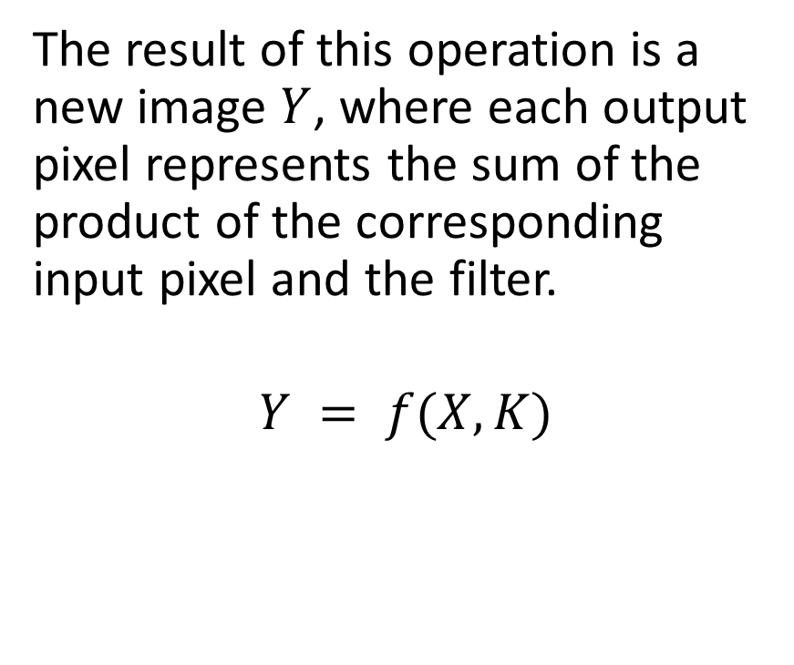
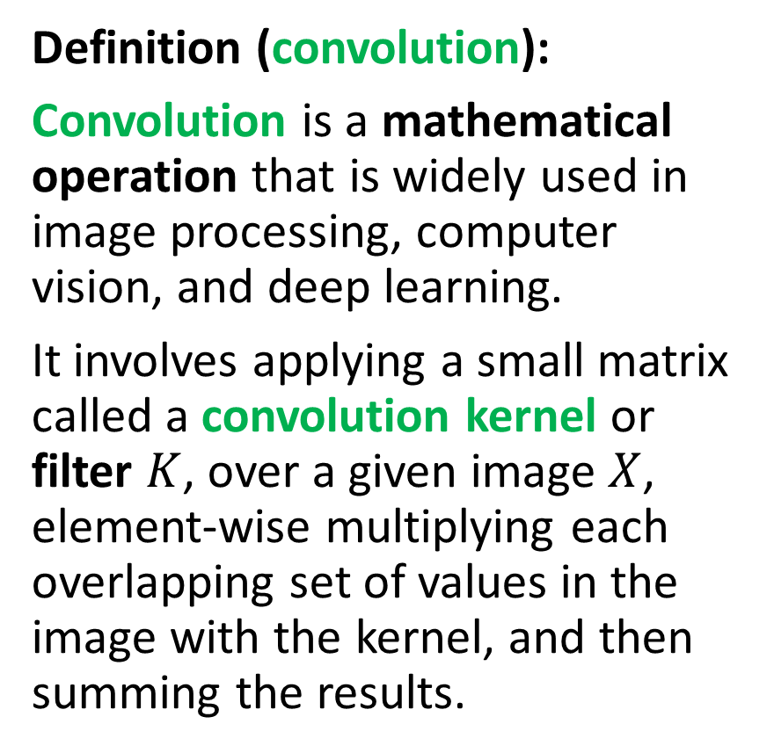
Introducing convolution!
Definition (convolution):
Convolution is a mathematical operation that is widely used in image processing, computer vision, and deep learning.
It involves applying a small matrix called a convolution kernel or filter $K$, over a given image $X$, element-wise multiplying each overlapping set of values in the image with the kernel, and then summing the results.
The result of this operation is a new image $Y$, where each output pixel represents the sum of the product of the corresponding input pixel and the filter.
$$Y = f(X, K)$$

Slide 20
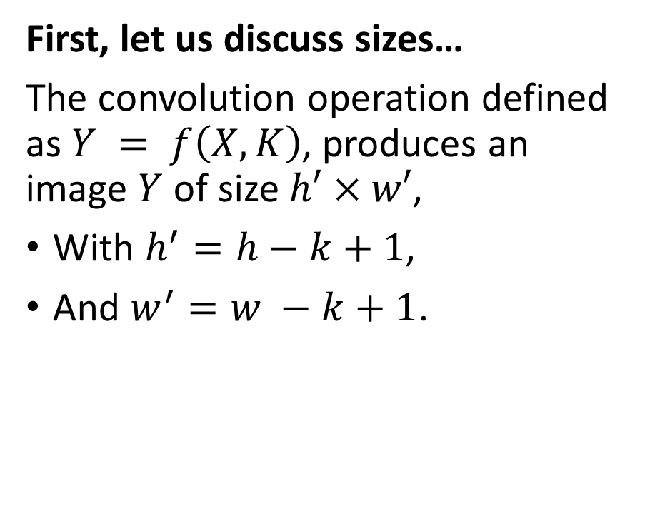
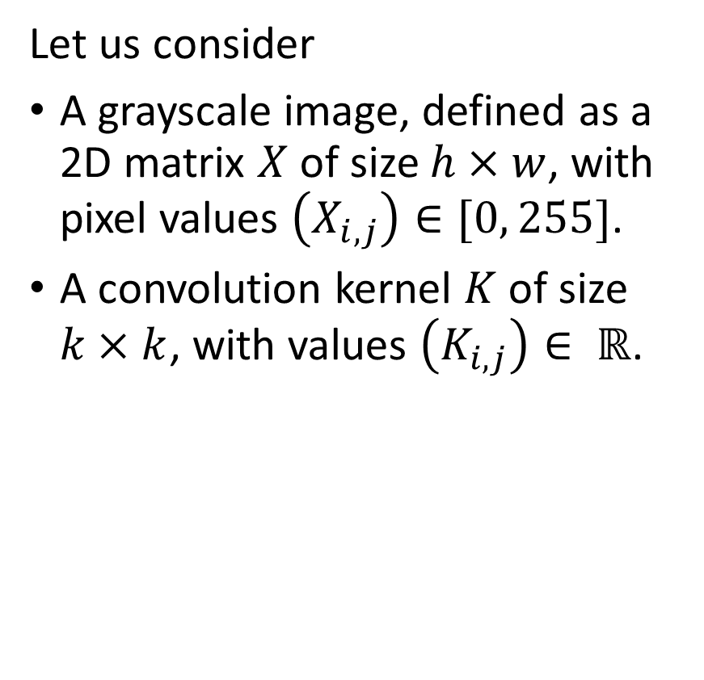
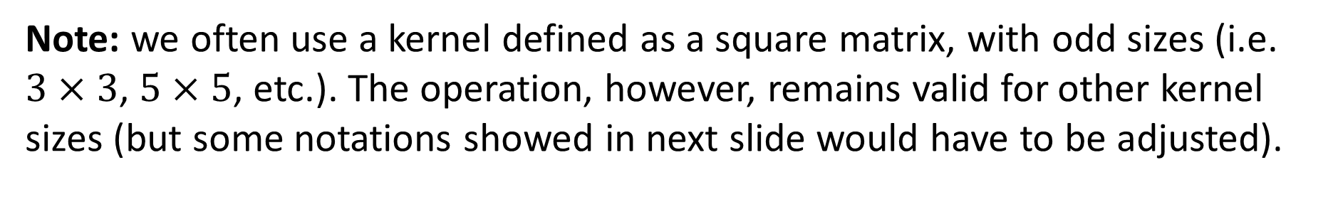
Introducing convolution!
Let us consider
A grayscale image, defined as a 2D matrix $X$ of size $h×w$, with pixel values $\left(X_{i,j}\right)∈[0, 255]$.
A convolution kernel $K$ of size $k×k$, with values $\left(K_{i,j}\right)∈ ℝ$.
First, let us discuss sizes…
The convolution operation defined as $Y = f\left(X, K\right)$, produces an image $Y$ of size $h′×w′$,
With $h^{′}=h−k+1$,
And $w^{′}=w −k+1$.
Note: we often use a kernel defined as a square matrix, with odd sizes (i.e. $3×3$, $5×5$, etc.). The operation, however, remains valid for other kernel sizes (but some notations showed in next slide would have to be adjusted).

Slide 21

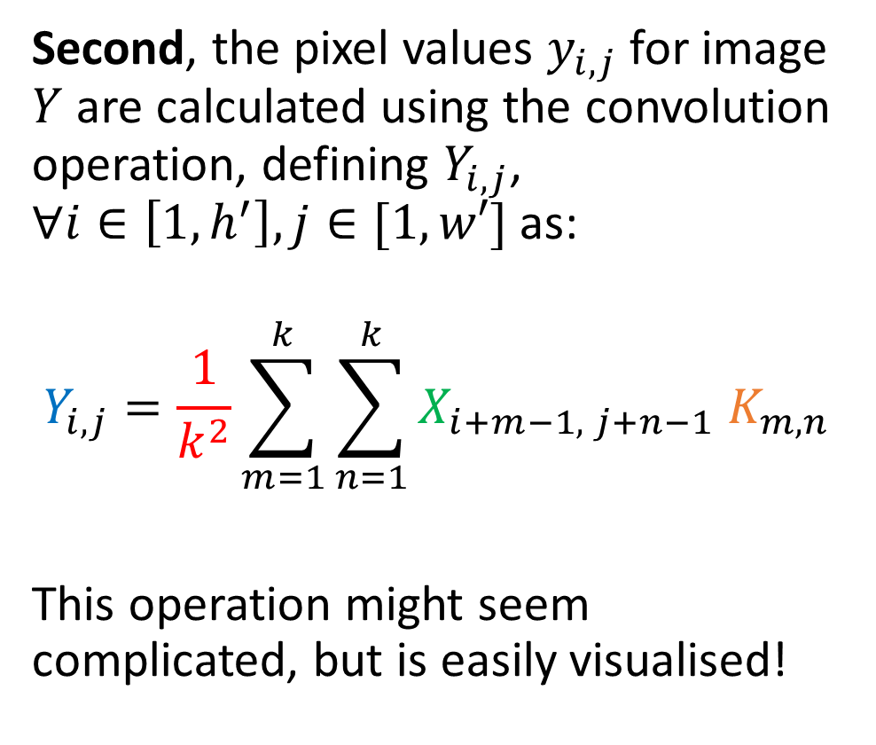


Introducing convolution!
1 | 2 | 4 | 2 | 1
4 | 7 | 3 | 2 | 1
4 | 5 | 2 | 3 | 1
2 | 1 | 7 | 8 | 4
3 | 2 | 4 | 7 | 8
X is 5 by 5
K is 3 by 3
Y is therefore 3 by 3.
(5-3+1 = 3)
$$X$$
Second, the pixel values $y_{i,j}$for image $Y$ are calculated using the convolution operation, defining $Y_{i,j}$, $∀i∈\left[1, h^{′}\right], j∈[1,w′]$ as:
$$Y_{i,j}=\frac{1}{k^{2}}\sum_{m=1}^{k}{\sum_{n=1}^{k}{X_{i+m−1, j+n−1} K_{m,n}}}$$
This operation might seem complicated, but is easily visualised!
1 | 0 | 1
0 | 2 | 1
1 | 0 | 1
$$K$$
… | … | …
… | … | …
… | … | …
$$Y$$

Slide 22
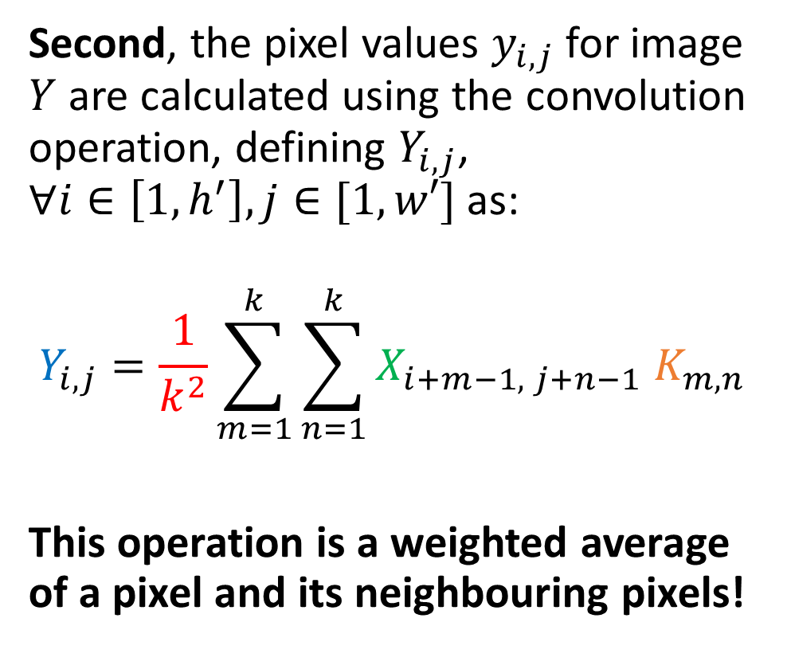
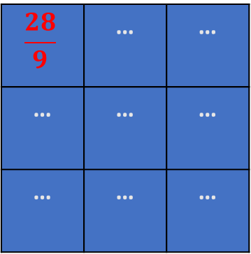
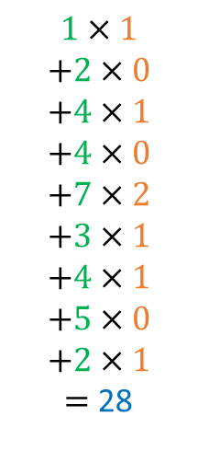
Introducing convolution!
1 | 2 | 4 | 2 | 1
4 | 7 | 3 | 2 | 1
4 | 5 | 2 | 3 | 1
2 | 1 | 7 | 8 | 4
3 | 2 | 4 | 7 | 8
$$1×1$$
$$+2×0$$
$$+4×1$$
$$+4×0$$
$$+7×2$$
$$+3×1$$
$$+4×1$$
$$+5×0$$
$$+2×1$$
$=$ 28
$$X$$
Second, the pixel values $y_{i,j}$for image $Y$ are calculated using the convolution operation, defining $Y_{i,j}$, $∀i∈\left[1, h^{′}\right], j∈[1,w′]$ as:
$$Y_{i,j}=\frac{1}{k^{2}}\sum_{m=1}^{k}{\sum_{n=1}^{k}{X_{i+m−1, j+n−1} K_{m,n}}}$$
This operation is a weighted average of a pixel and its neighbouring pixels!
1 | 0 | 1
0 | 2 | 1
1 | 0 | 1
$$K$$
$$\frac{28}{9}$$ | … | …
… | … | …
… | … | …
$$Y$$

Slide 23
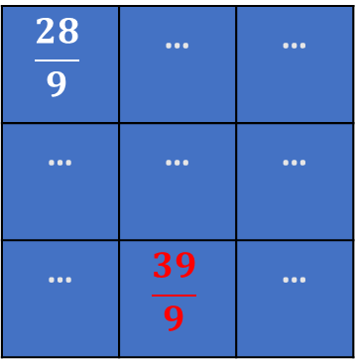
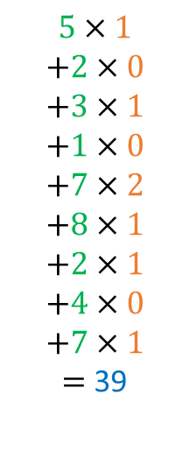
Introducing convolution!
1 | 2 | 4 | 2 | 1
4 | 7 | 3 | 2 | 1
4 | 5 | 2 | 3 | 1
2 | 1 | 7 | 8 | 4
3 | 2 | 4 | 7 | 8
$$5×1$$
$$+2×0$$
$$+3×1$$
$$+1×0$$
$$+7×2$$
$$+8×1$$
$$+2×1$$
$$+4×0$$
$$+7×1$$
$=$ 39
$$X$$
Second, the pixel values $y_{i,j}$for image $Y$ are calculated using the convolution operation, defining $Y_{i,j}$, $∀i∈\left[1, h^{′}\right], j∈[1,w′]$ as:
$$Y_{i,j}=\frac{1}{k^{2}}\sum_{m=1}^{k}{\sum_{n=1}^{k}{X_{i+m−1, j+n−1} K_{m,n}}}$$
This operation is a weighted average of a pixel and its neighbouring pixels!
1 | 0 | 1
0 | 2 | 1
1 | 0 | 1
$$K$$
$$\frac{28}{9}$$ | … | …
… | … | …
… | $$\frac{39}{9}$$ | …
$$Y$$

Slide 24

Introducing convolution!
1 | 2 | 4 | 2 | 1
4 | 7 | 3 | 2 | 1
4 | 5 | 2 | 3 | 1
2 | 1 | 7 | 8 | 4
3 | 2 | 4 | 7 | 8
$$5×1$$
$$+2×0$$
$$+3×1$$
$$+1×0$$
$$+7×2$$
$$+8×1$$
$$+2×1$$
$$+4×0$$
$$+7×1$$
$=$ 39
$$X$$
Second, the pixel values $y_{i,j}$for image $Y$ are calculated using the convolution operation, defining $Y_{i,j}$, $∀i∈\left[1, h^{′}\right], j∈[1,w′]$ as:
$$Y_{i,j}=\frac{1}{k^{2}}\sum_{m=1}^{k}{\sum_{n=1}^{k}{X_{i+m−1, j+n−1} K_{m,n}}}$$
1 | 0 | 1
0 | 2 | 1
1 | 0 | 1
$$K$$
$$\frac{28}{9}$$ | … | …
… | … | …
… | $$\frac{39}{9}$$ | …
$$Y$$
Note: Sometimes, the normalization term is removed and we may instead normalize the kernel (ensuring elements in kernel matrix sum up to 1), or not.

Slide 25
Introducing convolution!
1 | 2 | 4 | 2 | 1
4 | 7 | 3 | 2 | 1
4 | 5 | 2 | 3 | 1
2 | 1 | 7 | 8 | 4
3 | 2 | 4 | 7 | 8
$$5×1$$
$$+2×0$$
$$+3×1$$
$$+1×0$$
$$+7×2$$
$$+8×1$$
$$+2×1$$
$$+4×0$$
$$+7×1$$
$=$ 39
$$X$$
Second, the pixel values $y_{i,j}$for image $Y$ are calculated using the convolution operation, defining $Y_{i,j}$, $∀i∈\left[1, h^{′}\right], j∈[1,w′]$ as:
$$Y_{i,j}=\frac{1}{k^{2}}\sum_{m=1}^{k}{\sum_{n=1}^{k}{X_{i+m−1, j+n−1} K_{m,n}}}$$
1 | 0 | 1
0 | 2 | 1
1 | 0 | 1
$$K$$
$$\frac{28}{9}$$ | … | …
… | … | …
… | $$\frac{39}{9}$$ | …
$$Y$$
→ At the end of the day, convolution is just another type of matrix multiplication!

Slide 26
Convolution and Image Processing courses
Convolution is a key mathematical operation that is widely used in computer vision and image processing to apply a wide range of transformations on an image (enhancing contrast, blurring, edge detection, Instagram filters, etc).
If Computer Vision is a direction that interests you, I would strongly advise to take a course on Image Processing (with implementations in OpenCV, Photoshop, etc.) during your continued learning.
For instance: https://www.udemy.com/course/digital-image-processing-from-ground-up-in-python/

Slide 27
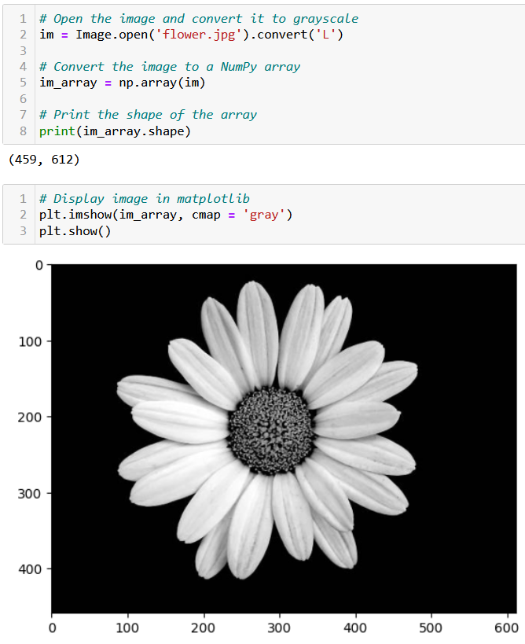
Testing convolution on images
Let us try the convolution operation on images to see their effect.
First, we need a greyscale image.

Slide 28
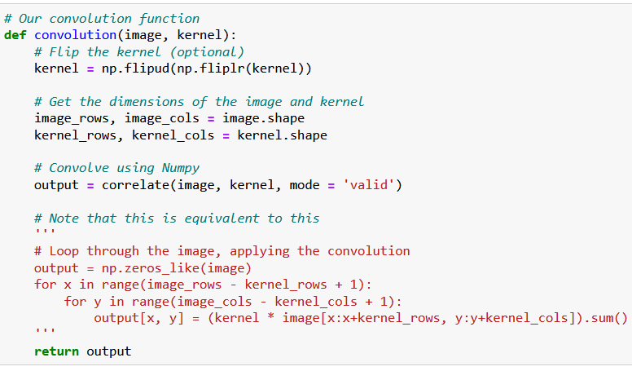
Testing convolution on images
Let us try the convolution operation on images to see their effect.
First, we need a greyscale image.
Second, we need a convolution function.

Slide 29
Testing convolution on images
What is the purpose of flipping the kernel?
Optional, but in short, flipping the kernel has mathematical and practical advantages that make it a common practice in deep learning.
(It has to do with signal processing, Fast Fourier Transform and the convolution theorem, out-of-scope).
https://stackoverflow.com/questions/45152473/why-is-the-convolutional-filter-flipped-in-convolutional-neural-networks

Slide 30
Testing convolution on images
Let us try the convolution operation on images to see their effect.
First, we need a greyscale image.
Second, we need a convolution function.
The magic for the transformation then happens when deciding which kernel to use.

Slide 31
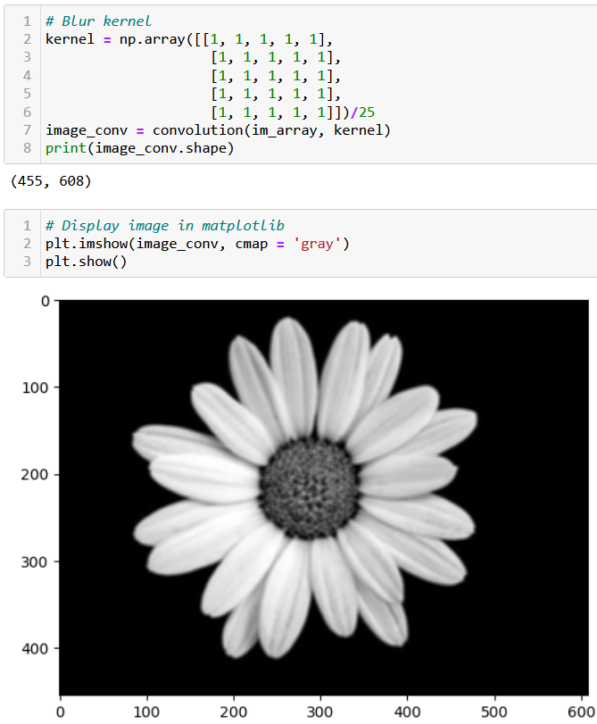
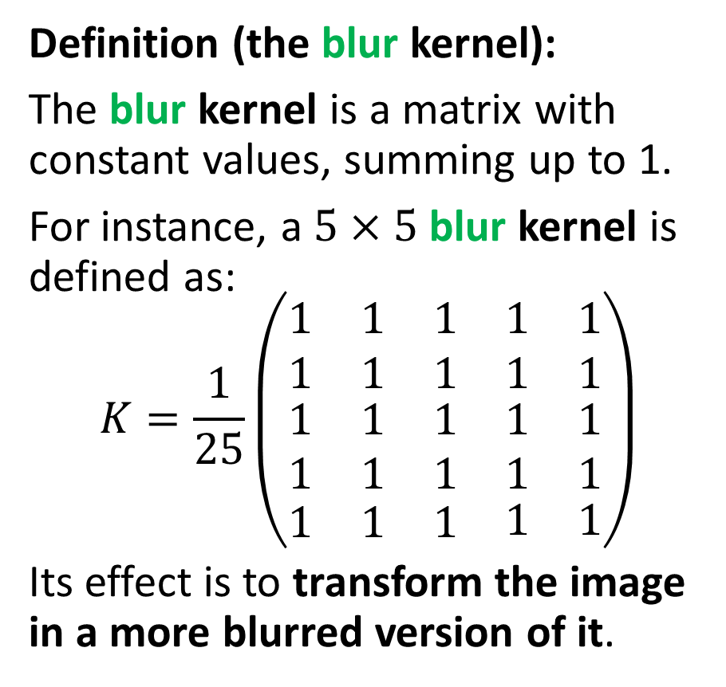
Testing convolution on images
Definition (the blur kernel):
The blur kernel is a matrix with constant values, summing up to 1.
For instance, a $5×5$ blur kernel is defined as:
$$K=\frac{1}{25}\left(\begin{matrix}\begin{matrix}1 & 1 & 1 \\ 1 & 1 & 1\end{matrix} & \begin{matrix}1 \\ 1\end{matrix} & \begin{matrix}1 \\ 1\end{matrix} \\ \begin{matrix}1 & 1 & 1 \\ 1 & 1 & 1\end{matrix} & \begin{matrix}1 \\ 1\end{matrix} & \begin{matrix}1 \\ 1\end{matrix} \\ \begin{matrix}1 & 1 & 1\end{matrix} & 1 & 1\end{matrix}\right)$$
Its effect is to transform the image in a more blurred version of it.

Slide 33
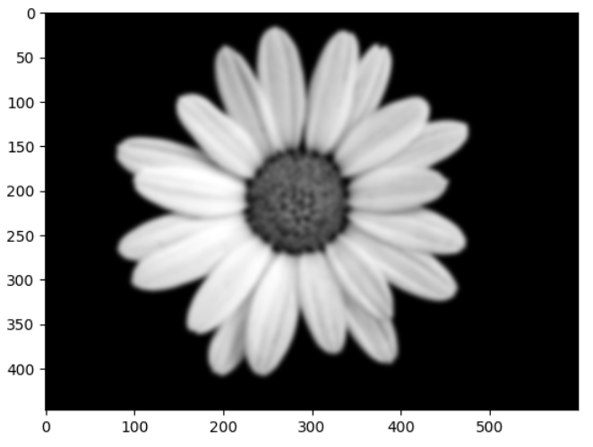
Can be repeated multiple times to increase the blur effect!

Slide 34
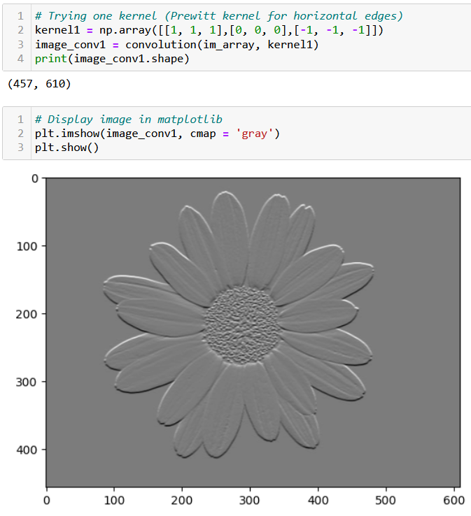
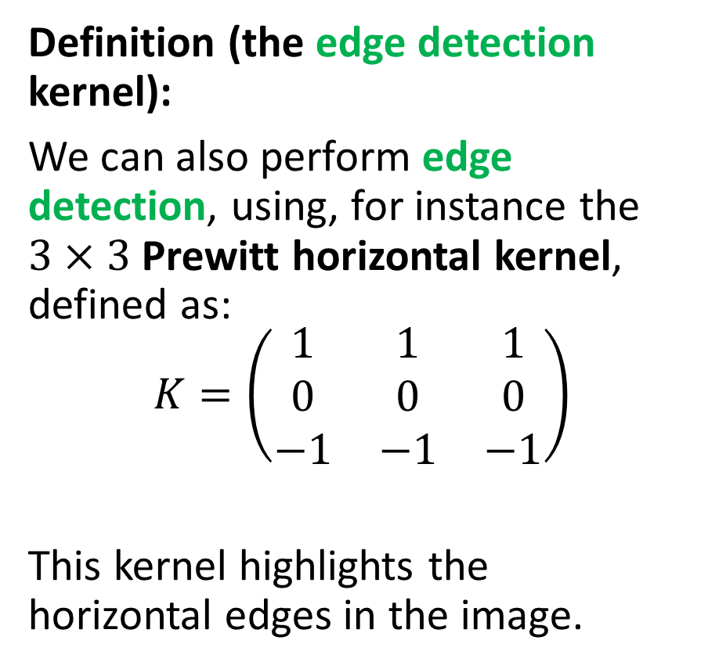
Testing convolution on images
Definition (the edge detection kernel):
We can also perform edge detection, using, for instance the $3×3$ Prewitt horizontal kernel, defined as:
$$K=\left(\begin{matrix}1 & 1 & 1 \\ 0 & 0 & 0 \\ −1 & −1 & −1\end{matrix}\right)$$
This kernel highlights the horizontal edges in the image.

Slide 35
Testing convolution on images
Definition (the edge detection kernel):
This kernel produces
a value close to zero when all pixels are similar,
and a non-zero value if there is a drastic change of values in the pixel and its neighbouring pixels.
Typically, it detects scenarios where the homophily property does not hold (i.e. an edge!).

Slide 37
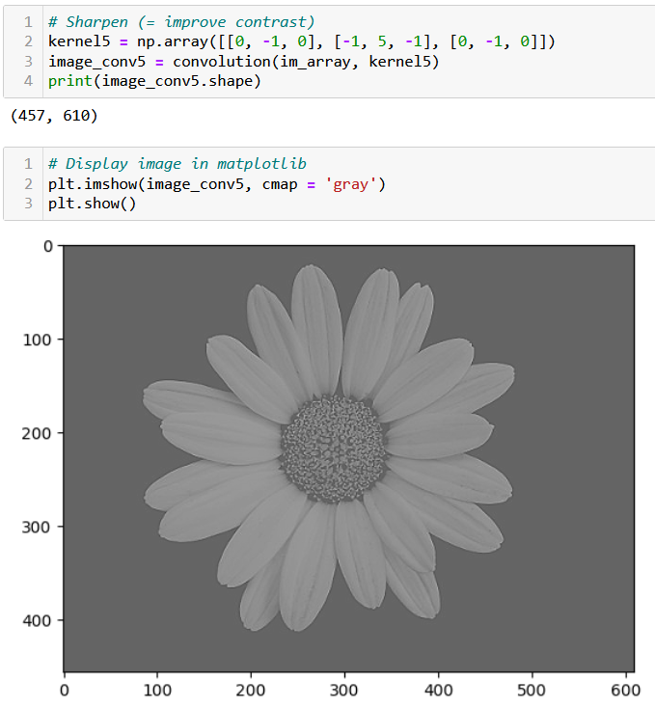
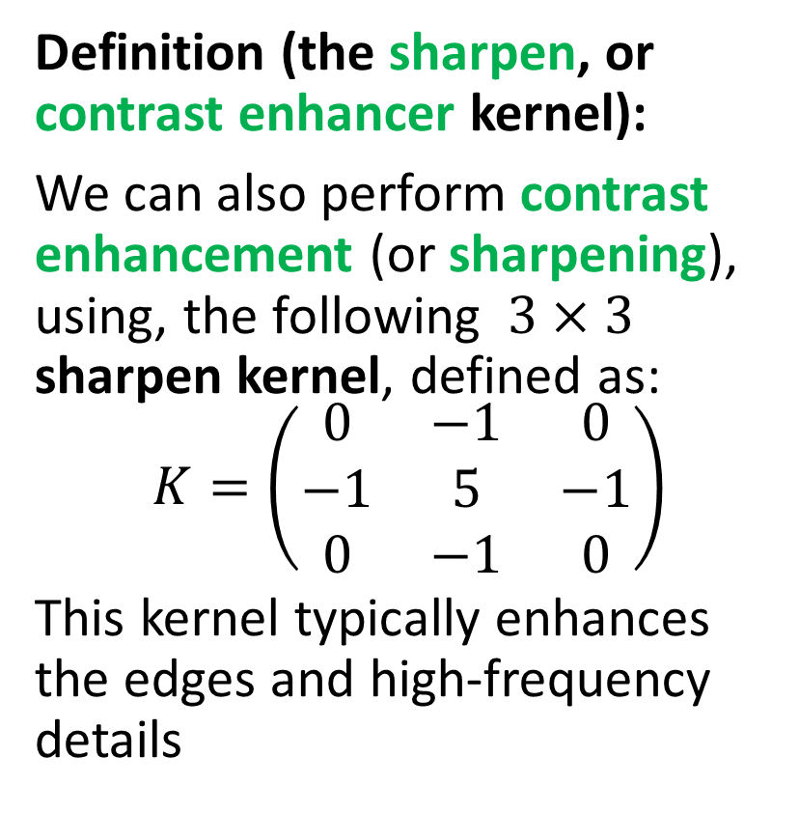
Testing convolution on images
Definition (the sharpen, or contrast enhancer kernel):
We can also perform contrast enhancement (or sharpening), using, the following $3×3$ sharpen kernel, defined as:
$$K=\left(\begin{matrix}0 & −1 & 0 \\ −1 & 5 & −1 \\ 0 & −1 & 0\end{matrix}\right)$$
This kernel typically enhances the edges and high-frequency details

Slide 39
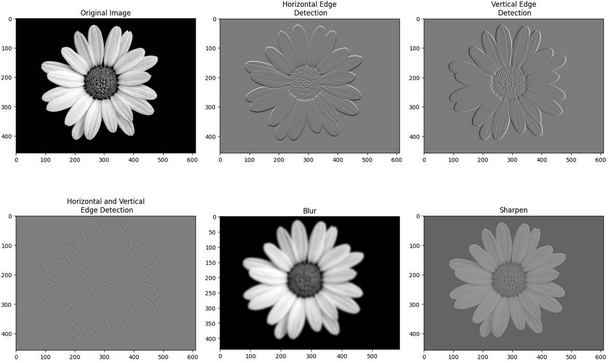
Many transformation kernels exist

Slide 40
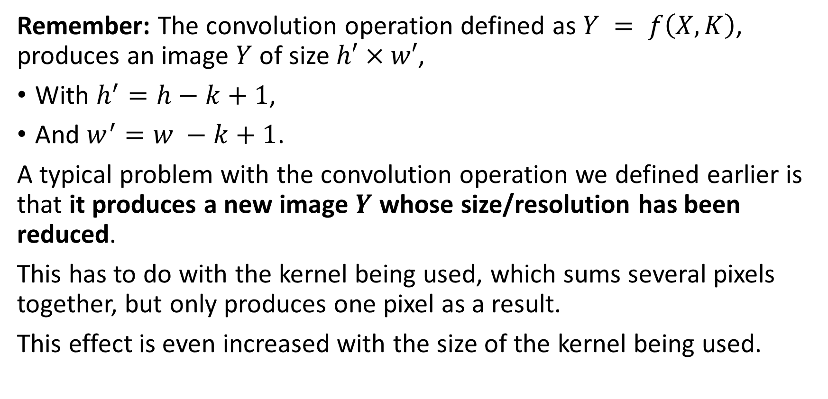
Downsizing
Remember: The convolution operation defined as $Y = f\left(X, K\right)$, produces an image $Y$ of size $h′×w′$,
With $h^{′}=h−k+1$,
And $w^{′}=w −k+1$.
A typical problem with the convolution operation we defined earlier is that it produces a new image $Y$ whose size/resolution has been reduced.
This has to do with the kernel being used, which sums several pixels together, but only produces one pixel as a result.
This effect is even increased with the size of the kernel being used.

Slide 41
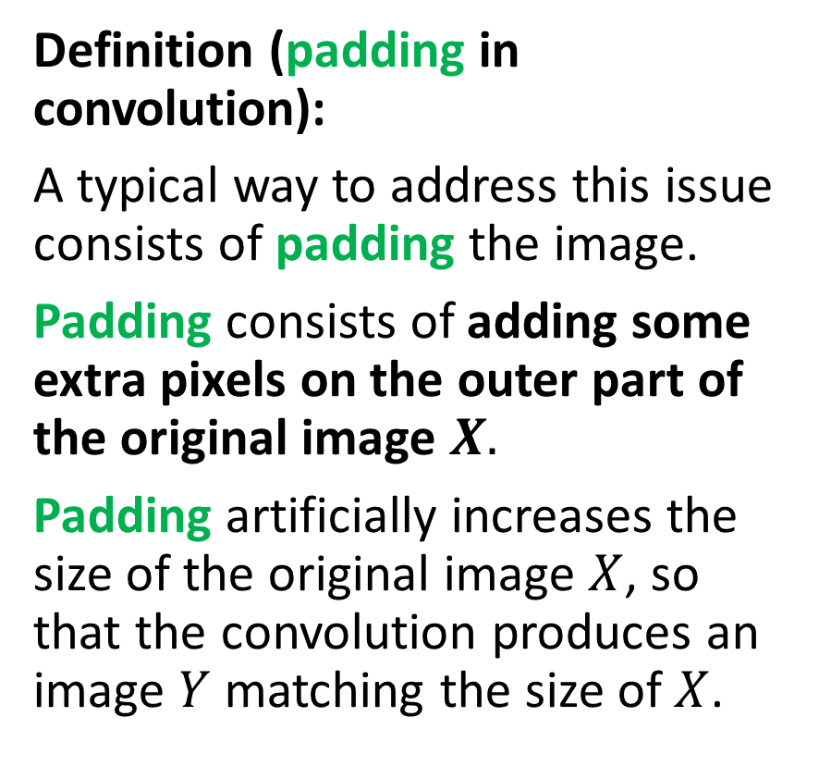
Adding some padding
Definition (padding in convolution):
A typical way to address this issue consists of padding the image.
Padding consists of adding some extra pixels on the outer part of the original image $X.$
Padding artificially increases the size of the original image $X$, so that the convolution produces an image $Y$ matching the size of $X$.
Three possible patterns for padding exist:
Valid/Same padding,
Zero padding,
Other types of padding…
This is typically be used to maintain the spatial dimensions of the input image and prevent the spatial dimensions of the output from getting too small.

Slide 42




Adding some padding
Valid padding: default configuration, no padding is applied to the input data. The convolution operation is only performed only on the valid parts of the input and the output size is then smaller than the input size.
$$Y = f(X, K)$$
$$K$$
$$Y$$
$$X$$

Slide 43

Adding some padding
Same padding: The number of zeros added (i.e. padding size $p$) is defined so that the image $Y$ has the same size as image $X$.
Zero padding: added pixels can simply be set to have the value 0.
0 | 0 | 0 | 0 | 0 | 0 | 0
0 |  |  |  |  |  | 0
0 |  |  |  |  |  | 0
0 |  |  |  |  |  | 0
0 |  |  |  |  |  | 0
0 |  |  |  |  |  | 0
0 | 0 | 0 | 0 | 0 | 0 | 0
$$Y = f(X, K)$$
$$K$$
$$Y$$
$$X$$

Slide 44
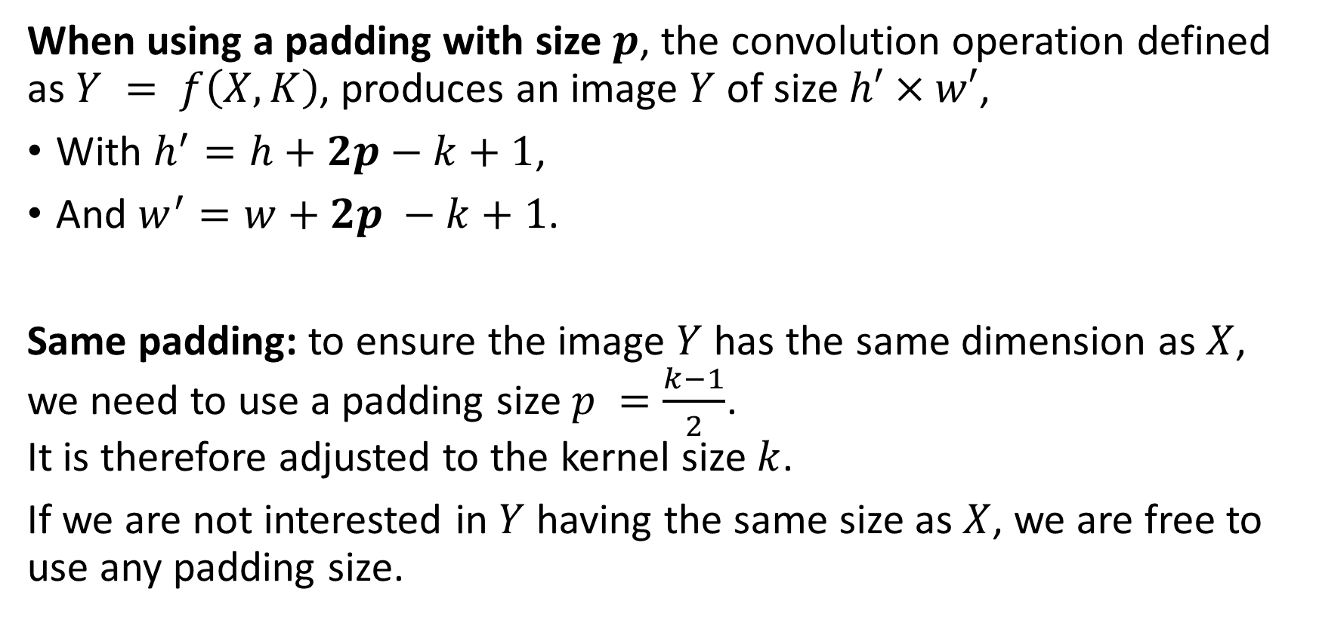
Adding some padding
When using a padding with size $p$, the convolution operation defined as $Y = f\left(X, K\right)$, produces an image $Y$ of size $h′×w′$,
With $h^{′}=h+2p−k+1$,
And $w^{′}=w+2p −k+1$.
Same padding: to ensure the image $Y$ has the same dimension as $X$, we need to use a padding size $p =\frac{k−1}{2}$. It is therefore adjusted to the kernel size $k$.
If we are not interested in $Y$ having the same size as $X$, we are free to use any padding size.

Slide 45

Adding some padding
Interpolation padding: instead of zeros, added pixels have the value of the closest pixel. Can also “zoom in” the original image and resize it to the expected number of pixels we want for image $X$ after padding.
1 | 1 | 5 | 5 | 2 | 4 | 4
1 | 1 | 5 | 5 | 2 | 4 | 4
2 | 2 | 4 | 5 | 2 | 2 | 2
3 | 3 | 1 | 1 | 1 | 1 | 1
4 | 4 | 4 | 7 | 2 | 3 | 3
5 | 5 | 0 | 0 | 3 | 1 | 1
5 | 5 | 0 | 0 | 0 | 1 | 1
$$Y = f(X, K)$$
$$K$$
$$Y$$
$$X$$

Slide 46
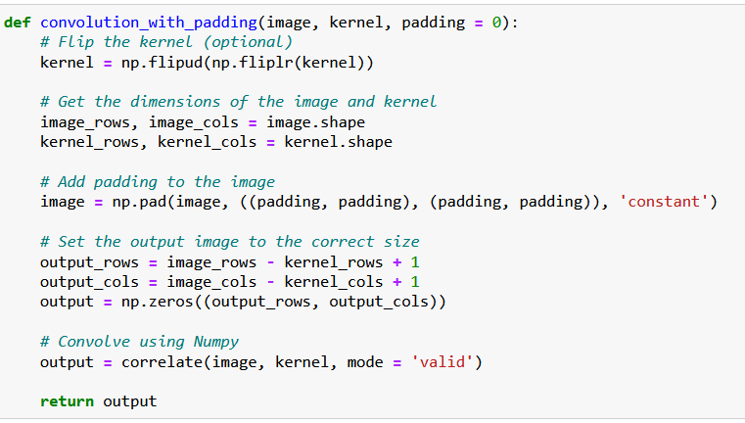
Adding some padding
0 | 0 | 0 | 0 | 0 | 0 | 0
0 |  |  |  |  |  | 0
0 |  |  |  |  |  | 0
0 |  |  |  |  |  | 0
0 |  |  |  |  |  | 0
0 |  |  |  |  |  | 0
0 | 0 | 0 | 0 | 0 | 0 | 0
Padding is simply implemented using the pad() function.
It adds a layer of zeroes to the matrix image, of size padding on top, bottom, right and left side of the image matrix.

Slide 47
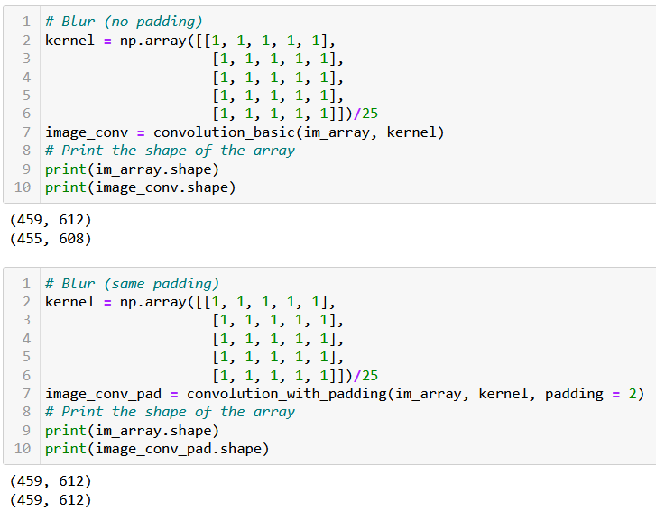
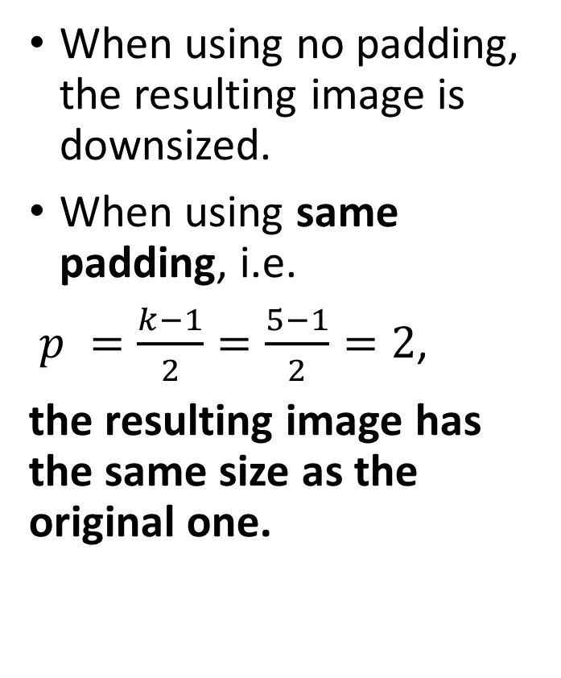
Adding some padding
When using no padding, the resulting image is downsized.
When using same padding, i.e.
$p =\frac{k−1}{2}=\frac{5−1}{2}=2$,
the resulting image has the same size as the original one.

Slide 48
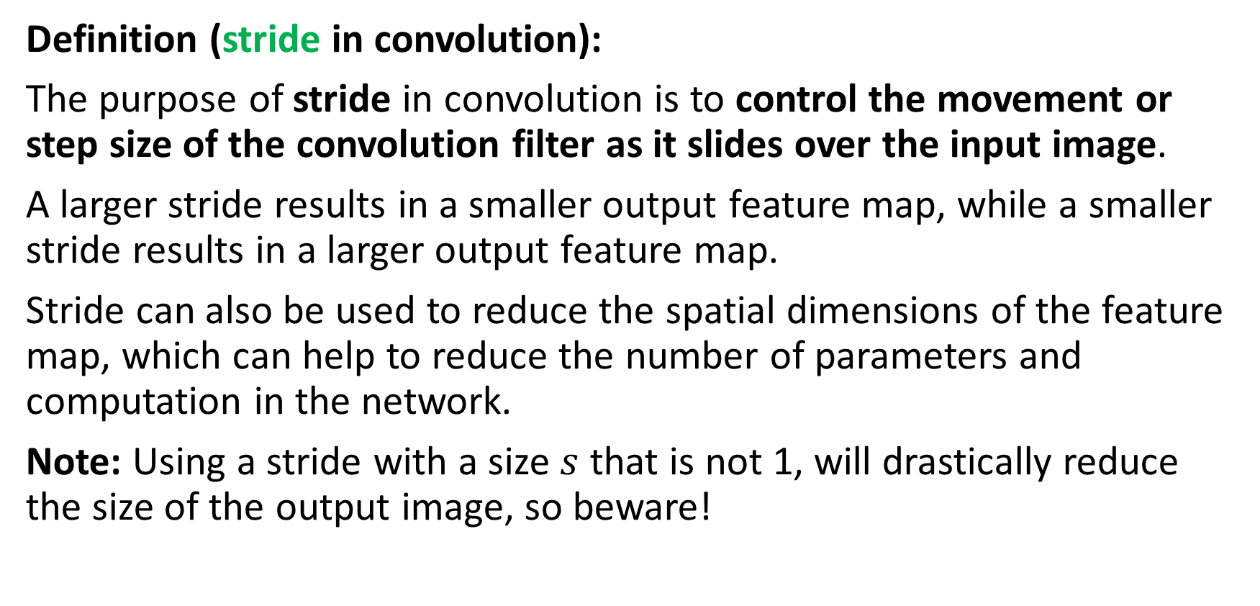
Adding a stride
Definition (stride in convolution):
The purpose of stride in convolution is to control the movement or step size of the convolution filter as it slides over the input image.
A larger stride results in a smaller output feature map, while a smaller stride results in a larger output feature map.
Stride can also be used to reduce the spatial dimensions of the feature map, which can help to reduce the number of parameters and computation in the network.
Note: Using a stride with a size $s$ that is not 1, will drastically reduce the size of the output image, so beware!

Slide 49

Adding a stride
Below, we demonstrate what a stride of size $s = 2$does (no padding).
First, use the convolution as before, next elements to be used are “two steps” away from the first position, and so on.
1 | 1 | 5 | 5 | 2 | 4 | 4
1 | 1 | 5 | 5 | 2 | 4 | 4
2 | 2 | 4 | 5 | 2 | 2 | 2
3 | 3 | 1 | 1 | 1 | 1 | 1
4 | 4 | 4 | 7 | 2 | 3 | 3
5 | 5 | 0 | 0 | 3 | 1 | 1
5 | 5 | 0 | 0 | 0 | 1 | 1
…
$$Y = f(X, K)$$
$$K$$
$$Y$$
$$X$$

Slide 50
Adding a stride
Below, we demonstrate what a stride of size $s = 2$does (no padding).
First, use the convolution as before, next elements to be used are “two steps” away from the first position, and so on.
1 | 1 | 5 | 5 | 2 | 4 | 4
1 | 1 | 5 | 5 | 2 | 4 | 4
2 | 2 | 4 | 5 | 2 | 2 | 2
3 | 3 | 1 | 1 | 1 | 1 | 1
4 | 4 | 4 | 7 | 2 | 3 | 3
5 | 5 | 0 | 0 | 3 | 1 | 1
5 | 5 | 0 | 0 | 0 | 1 | 1
… | …
$$Y = f(X, K)$$
$$K$$
$$Y$$
$$X$$

Slide 51
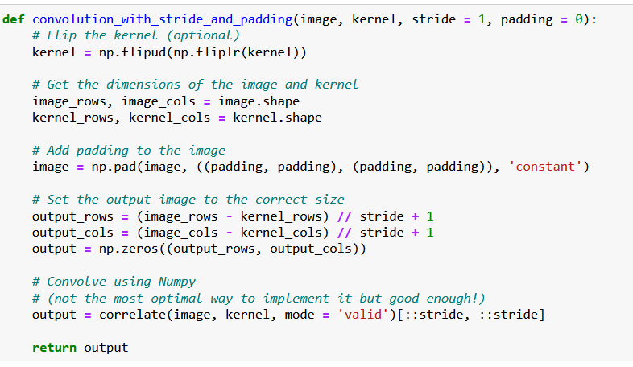
Adding a stride
Stride is easily implemented by using a slicing in the result of the correlation.
This is not the most optimized way to do it, however!
(We do not care so much, as we will use the PyTorch version of convolution after this!)

Slide 52
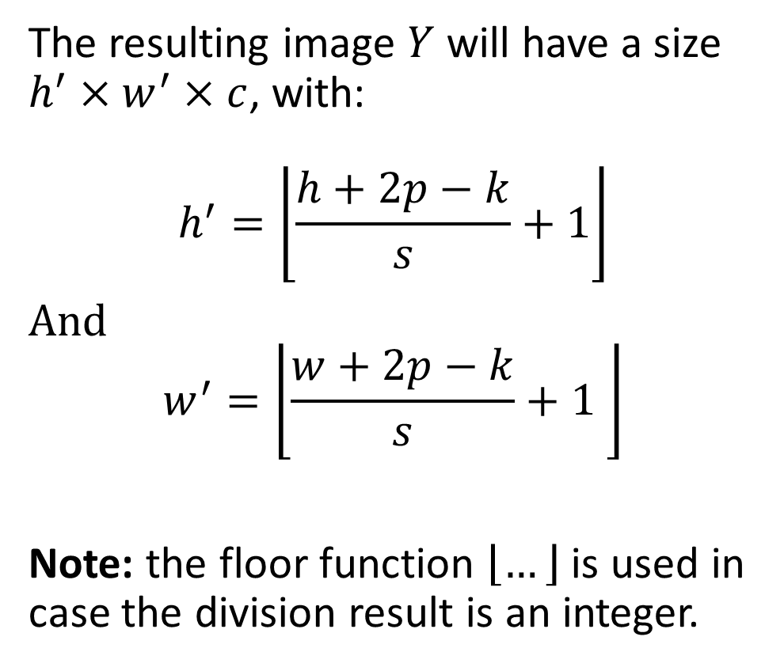
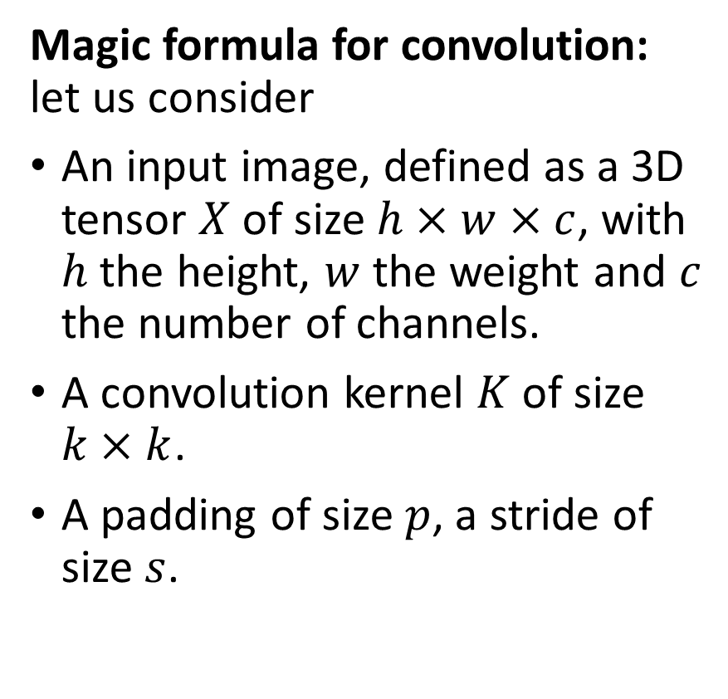
The (final) magic formula for convolution
Magic formula for convolution: let us consider
An input image, defined as a 3D tensor $X$ of size $h×w×c$, with $h$ the height, $w$ the weight and $c$ the number of channels.
A convolution kernel $K$ of size $k×k$.
A padding of size $p$, a stride of size $s$.
The resulting image $Y$ will have a size $h^{′}×w^{′}×c$, with:
$$h^{′}=\left\lfloor \frac{h+2p−k}{s}+1\right\rfloor$$
And $$w^{′}=\left\lfloor \frac{w+2p−k}{s}+1 \right\rfloor$$
Note: the floor function $\left\lfloor …\right\rfloor$ is used in case the division result is an integer.

Slide 53
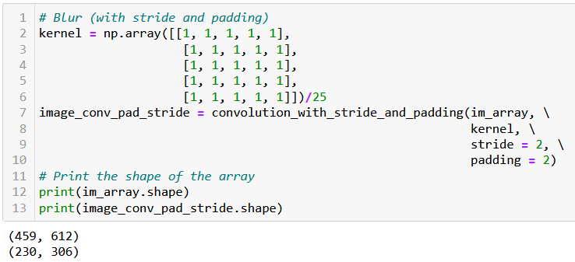
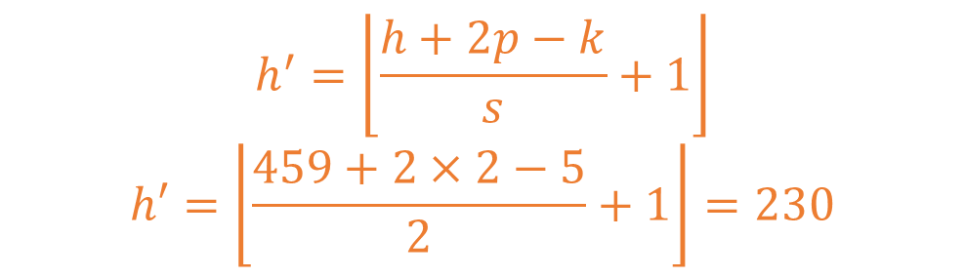
Adding a stride
$$h^{′}=\left\lfloor \frac{h+2p−k}{s}+1\right\rfloor$$
$$h′=\left\lfloor \frac{459+2×2−5}{2}+1\right\rfloor =230$$

Slide 54
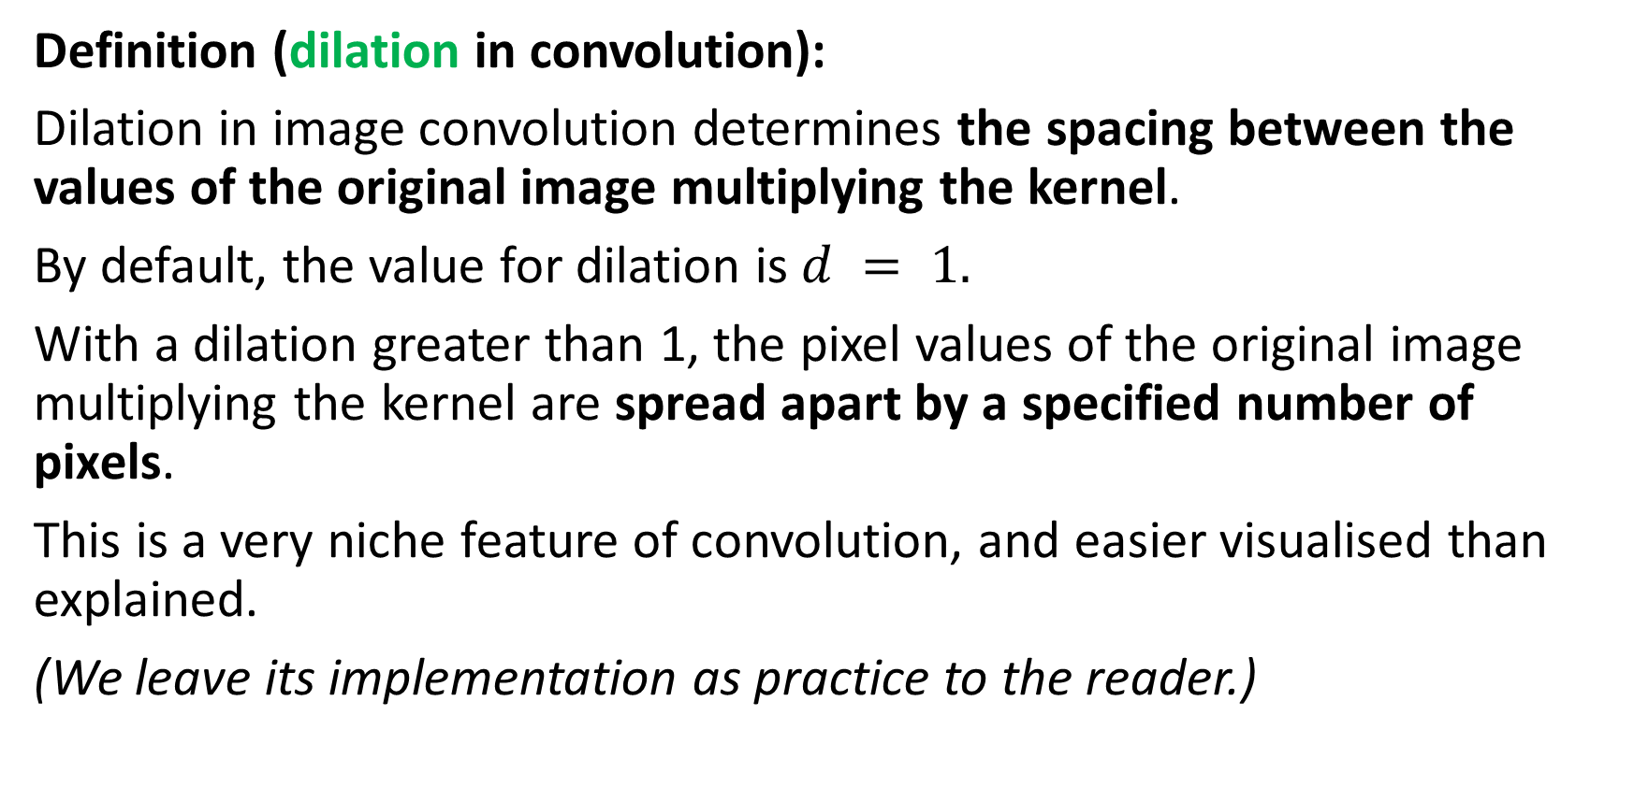
Adding a dilation
Definition (dilation in convolution):
Dilation in image convolution determines the spacing between the values of the original image multiplying the kernel.
By default, the value for dilation is $d = 1.$
With a dilation greater than 1, the pixel values of the original image multiplying the kernel are spread apart by a specified number of pixels.
This is a very niche feature of convolution, and easier visualised than explained.
(We leave its implementation as practice to the reader.)

Slide 55

Adding a dilation
Below, we demonstrate what a dilation of size $d = 2$does. Our convolution uses a stride with default value set to 1, padding is also set to its default value 0.
1 | 1 | 5 | 5 | 2 | 4 | 4
1 | 1 | 5 | 5 | 2 | 4 | 4
2 | 2 | 4 | 5 | 2 | 2 | 2
3 | 3 | 1 | 1 | 1 | 1 | 1
4 | 4 | 4 | 7 | 2 | 3 | 3
5 | 5 | 0 | 0 | 3 | 1 | 1
5 | 5 | 0 | 0 | 0 | 1 | 1
…
$$Y = f(X, K)$$
$$K$$
$$Y$$
$$X$$

Slide 56
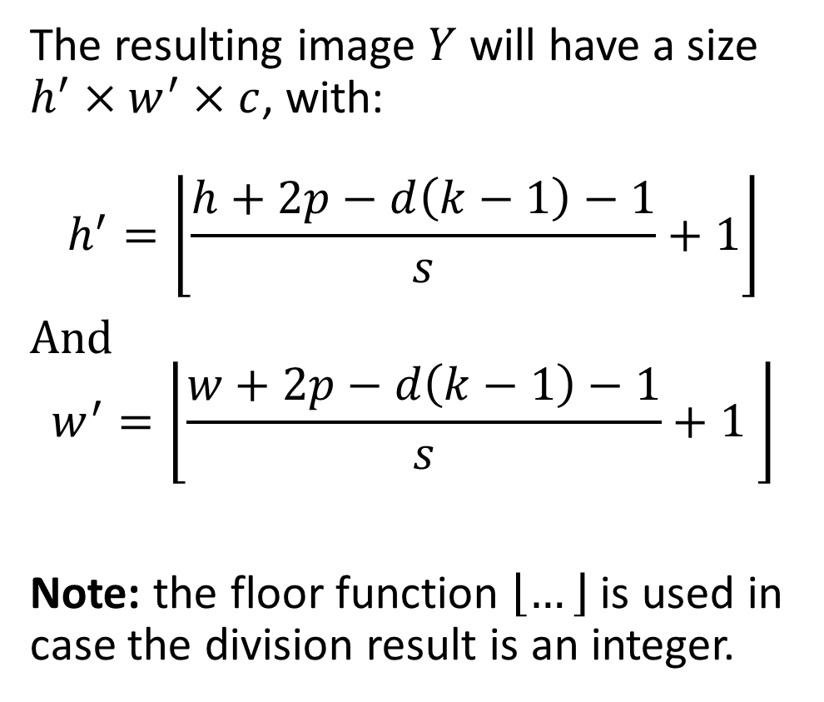
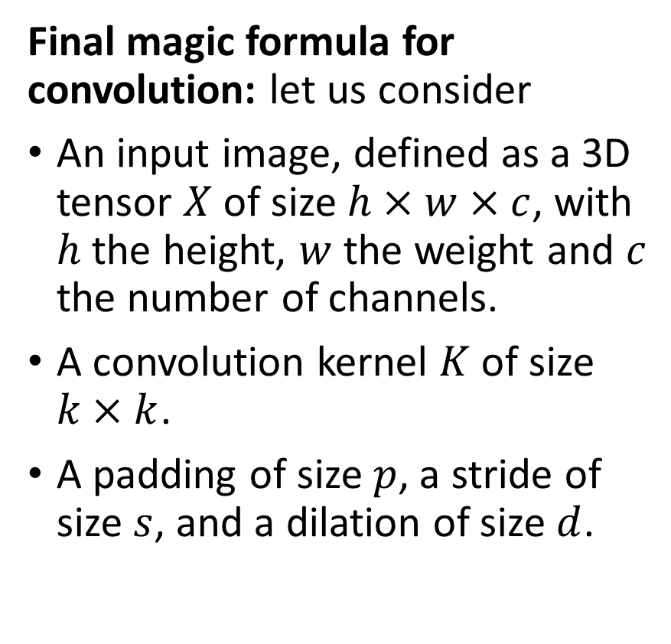
The (final) magic formula for convolution
Final magic formula for convolution: let us consider
An input image, defined as a 3D tensor $X$ of size $h×w×c$, with $h$ the height, $w$ the weight and $c$ the number of channels.
A convolution kernel $K$ of size $k×k$.
A padding of size $p$, a stride of size $s$, and a dilation of size $d$.
The resulting image $Y$ will have a size $h^{′}×w^{′}×c$, with:
$$h^{′}=\left\lfloor \frac{h+2p−d\left(k−1\right)−1}{s}+1\right\rfloor$$
And $$w^{′}=\left\lfloor \frac{w+2p−d\left(k−1\right)−1}{s}+1 \right\rfloor$$
Note: the floor function $\left\lfloor …\right\rfloor$ is used in case the division result is an integer.

Slide 57
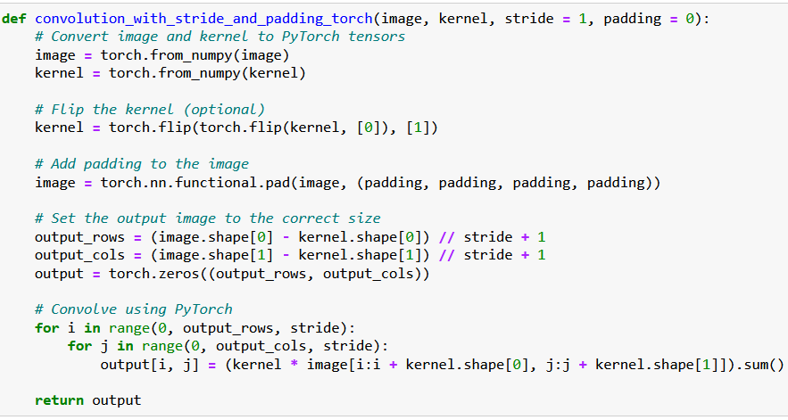
Implementing a custom Conv in PyTorch (with stride and padding, no dilation)

Slide 58
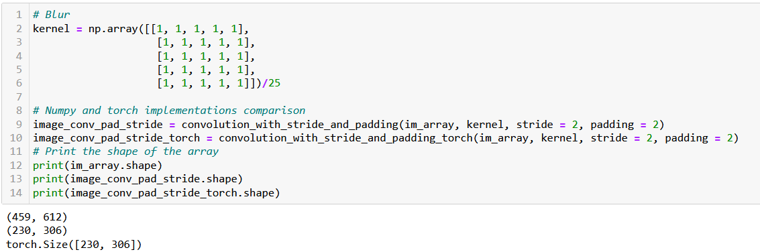
Implementing a custom Conv in PyTorch (with stride and padding, no dilation)
The PyTorch and the Numpy implementations are indeed equivalent.

Slide 59

The Conv2d in PyTorch
PyTorch has a Conv2d function implementing said convolution.
We will rely on it from now on.

Slide 60
The Conv2d in PyTorch
Note, however that this layer has two trainable parameters:
Weight (which is our kernel, whose values will be decided later during training).
Bias (which was not there before?)

Slide 61

The Conv2d in PyTorch
Note, however that this layer has two trainable parameters:
Weight (which is our kernel, whose values will be decided later during training).
Bias (which was not there before?)
Bias is simply added to our convolution operation, following the intuition of the $WX + b$operation from earlier.
$$Y_{i,j}=\frac{1}{k^{2}}\sum_{m=1}^{k}{\sum_{n=1}^{k}{X_{i+m−1, j+n−1} K_{m,n}}}+b$$

